Slide 1
Simple Hardware Resource Viewer
Group 10:
Taylor DeMarche

Slide 2
Introduction:
This software is intended to be a straightforward view at the most important hardware usage. It includes an interface and is relevant as the strain on hardware can display what the operating system is doing and more importantly, what it is struggling with that is bottlenecking performance.

Slide 3
Overview:
Built with Python
Minimalist Interface
Presents the current hardware usage for:
CPU
RAM
Disk/SSD Storage
Network Download/Upload
Create a log of the past data
5 second intervals.

Slide 4
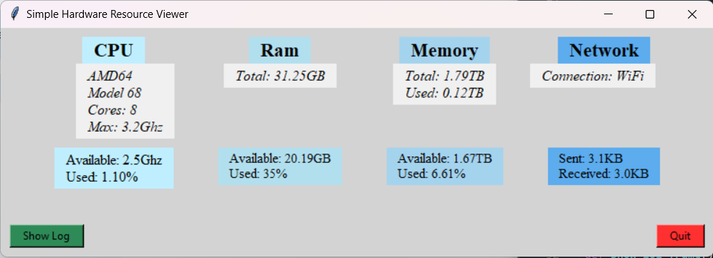

Slide 5
Methodology:
Created using Python 3.12 with Spyder IDE.
Modules/Packages:
Tkinter - interface
Psutil – Usage information
Platform – Hardware information
RE - Regular Expressions

Slide 6
Implementation:
I built the interface using tkinter’s grid layout. Adding text, frames, labels, etc. into the grid and positioning them manually while allowing the interface to be resized without it losing the orientation.
Using regular expressions, I was able to parse out the hardware information like the CPU’s manufacturer and model number.
Usage information was pulled every 5 seconds using an update loop.
Buttons were added to show/hide the log of previous data and to quit the application.

Slide 7
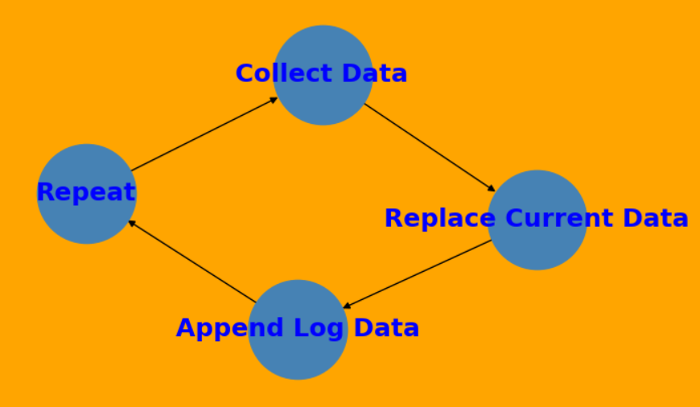
Control Flow:
Collect Data from Hardware
Replace the Current Data
Append the new data to the Log
Repeat every 5 seconds

Slide 8
Improvements:
Create a better stylized interface that is even more eye catching and easier to read at a glance.
Another section/tab/window that shows applications running along with their individual data usage (including a filter for user or OS software in the list)
Graphical Data for stand out visuals.
Customization for users (colors/style, update interval, hide/show certain sections of data, etc).

Slide 9
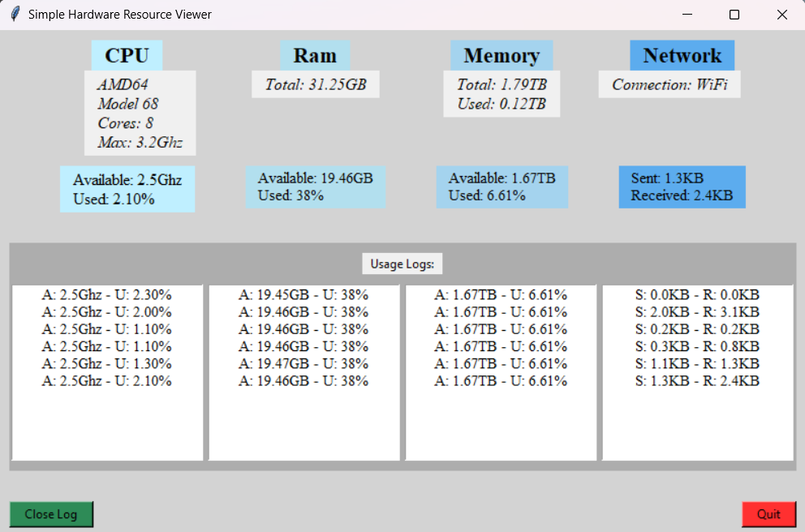
Results:

Slide 10
Conclusion:
While challenging at times, it was a very rewarding experience to have the project come together piece by piece with a full understanding of each part. Initially I regretted working alone. However, now that I have a unique project where I can feel comfortable modifying anything and everything, I’m grateful and excited to learn how to do more and more in my future career.

